Slide 1
Library Data
Solution for cleaning, analysing & reporting library metrics

Slide 2
Solution Architecture

Slide 3
Proposed Solution Process Flow in User Terms
CSV File
Web Portal
Python Application
Python application runs in the background, cleaning data & quarantining data with issues
User uploads a csv file manually
Cleaned CSV File
Power BI Report
System returns a cleaned csv file to the user for immediate download
System saves cleaned file, quarantined file, & process metrics, to a database for use in reporting

Slide 4
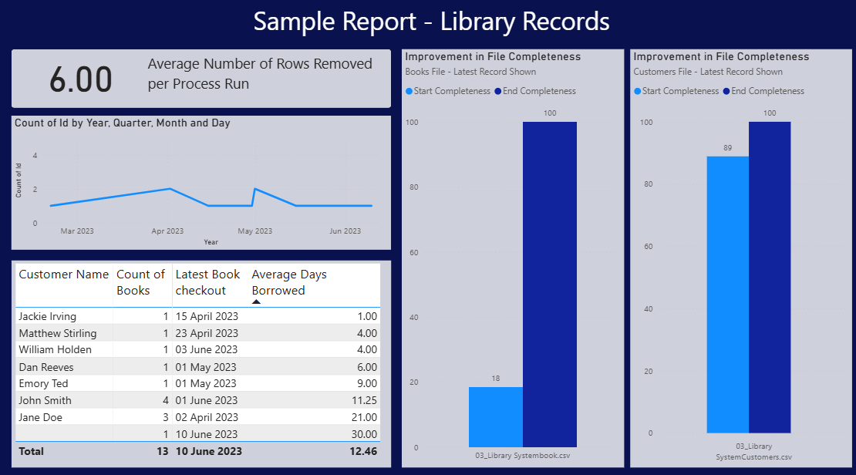
Proposed Solution Example Power BI Report – General Monitoring

Slide 5
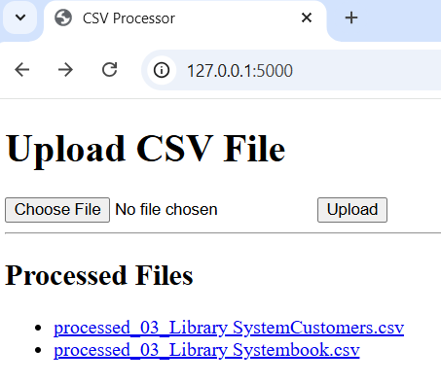
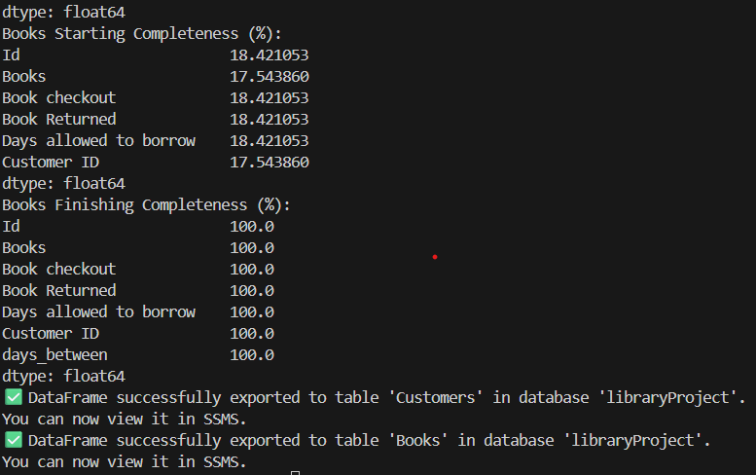
Proposed Solution Screenshots of Demo Build
User Interface
Process Output
Output for User
A web page hosted on a virtual machine. A user accesses via URL and uploads a csv data file.
An example of the output within the process terminal as it cleans & saves the file using python
The output seen by the user after processing, presenting them with a cleaned csv file to download.

Slide 6
Risks & Issues

Slide 7
SWOT Analysis
Strengths Allows scalability for future data files that may be different Provides users with options for how the output is used Creates a simple end-to-end solution for viewing Library data from manual csv records | Weaknesses Currently relies on users regularly inputting csv files – automation would be possible to mitigate this and ensure seamless reporting Updates may require short periods of downtime with only 1 database storing the outputs – backups are recommended but this has a cost to consider
Opportunities Could be developed to work with CRM software and database data Can be further developed using Docker swarm to deliver to other libraries Can be developed to give users support in improving their data input based on file contents | Threats If the library upgrades to a new system/CRM tool, there will be development needed and this could create a gap in reporting availability during transition Security on the server/virtual machine needs to be rigorously maintained to prevent threat actors uploading malicious files into the system

Slide 8
Build a presentation for the library client with a proposed solution. You must include:
An Architecture Diagram
Proposed Solution
A PowerBI dashboard to track the pipeline runs along with 3 Data Engineering metrics (this can be manual for today).
Demo (if novel)
Risks & Issues
SWAT Analysis
Stretch: Demo/Test Docker Swarm and explain how this would fit into the above.

